Slide 1
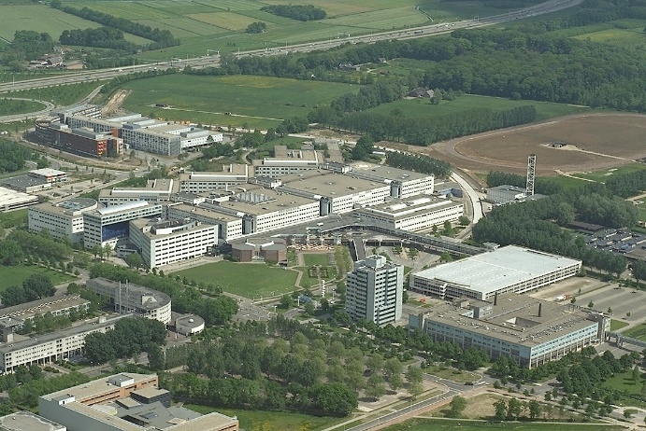
AI4HEALTH and UMC Utrecht AI strategy
Carl Moons
Professor Methods Clinical Research, Julius Center, UMC Utrecht
Director AI for Health, UMC Utrecht/Utrecht University
Director Health Innovation Netherlands (HI-NL)
Leading various international AI-Consortia
P.I. AI4HEALTH
Editor in Chief Cochrane Handbook Reviews of Prognosis & Prediction Algorithms
Editor in Chief BMC Diagnosis & Prognosis Research

Slide 2

AI4HEALTH
Transitioning towards Data- & AI-driven Healthcare

Slide 3
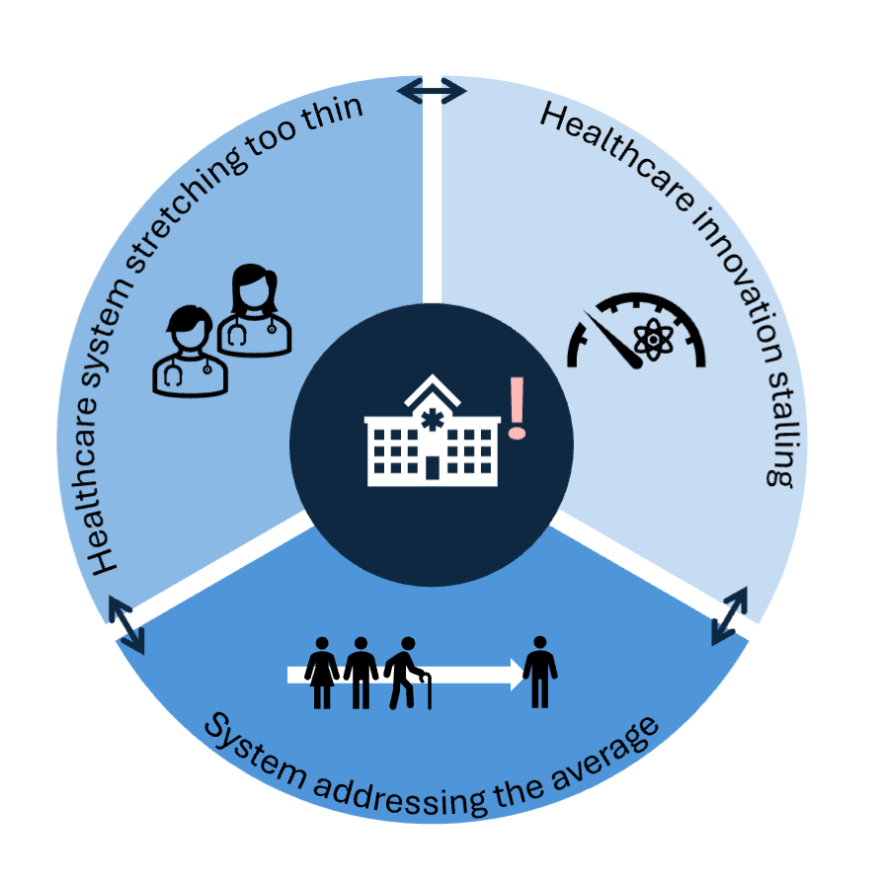
Societal, scientific and commercial challenges – transitions needed
Challenge 2
Escalating demand qualified personnel
Overburdened, fragile workforce
Increasingly less accessible, equitable, sustainable
Challenge 3
Protracted, costly innovation pipelines
Delayed access
Challenge 1
Limited personalisation/precision of care
Not leveraging emerging Data & AI-technologies
Notes:
Our health-care, -research and –innovation cycle all under pressure
Transitions on all playfields are required.

Slide 4



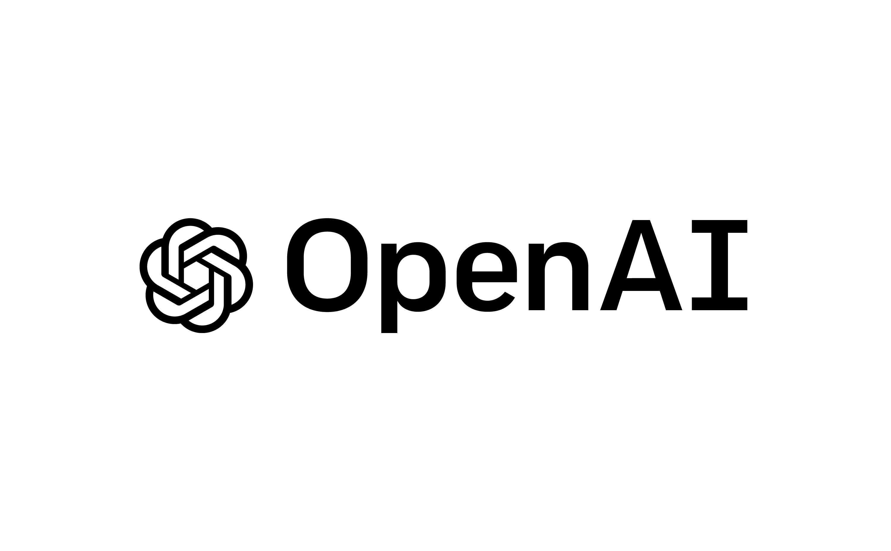
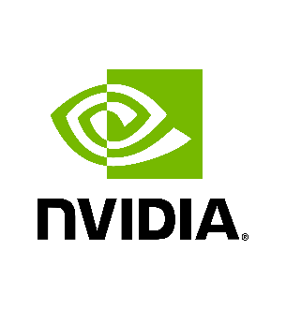



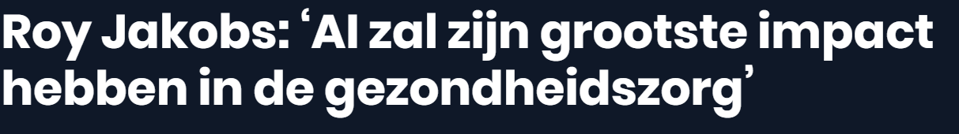
AI is everywhere already – except health domain
Notes:
AI application in healthcare are being rapidly developed.

Slide 5
Capitalization on AI’s omnipresence
AI = multimodal and multiple locations
Notes:
AI holds the promse: is simply everywhere – not the luxury not tot embark on it
AI everywhere & disruptive: Must capitalize on its potential by building and transitioning the System
Unique in history: AI holds the promise simultaneously multiple data types (not just numerical) & data sources/locations (not data movements to 1 place)

Slide 6

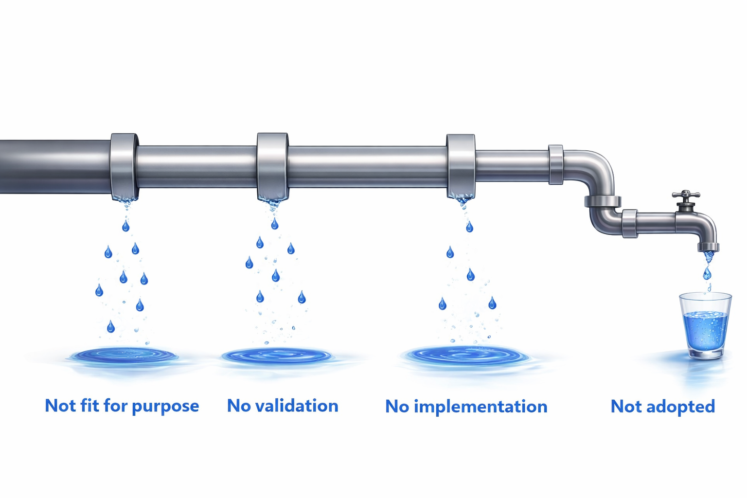
Persistent system barriers hamper AI potential – transitions needed
Valley 1
CE
Valley 2
Impact &
Implementation
Valley 3
Deployment &
Upscaling
Idea of
AI solution
Widescale use of AI solution
Not
fit for purpose
No validation
No implementation
Not
adopted
6
Notes:
AI Multiple valleys of death & too many stakeholders (not just one) & too many forms of AI & too much focus on TRL only
Data en AI potential untrapped: persistent system barriers → we must build and transition that system
But: AI is not a drug – no one-size fits all. For drugs the pathway is rather paved in past 70 years (one-size-fits-all appraoch – and drugs rather uniform

Slide 7
AI4HEALTH Comprehensive: >€87M co-funding; >39M cash
Strategic supporters
Academic, technical, higher professional researchers
Charities
Healthcare partners
AI4Health
Consortium
Industry & private sector stakeholders
Data-rich environments & research organisations
Public, societal & policy actors
Notes:
But realize: innovation and transition does not just happen by collaborating: know the valleys of death, know the blind spots, address them in co-design, illustrate it!!
Emphasize approaching and transition the system requires inclusion of the system, all relevant stakeholders that play a role somewhere in the pipeline.
Mention also the higher professional schools (HBO’s) , industry, including Food (Wageningen – explicit use case)
Explicitly mention existing ELSA labs to emphasize ethical and legal aspects, but also equity ;
Strategic supporters wrt start/scale ups and SMEs
Emphasize that 40 is understatement: all hospitals, all govenrmental organisations that play a role; .
Emphasize that this is a nationwide consortium, creating a large scale infrastructure that combines relevant tools, technology, methodology, and human expertise and as such has the critical mass, profile, resourcing and degrees of organization to create a lasting AI ecosystem.

Slide 8
AI4HEALTH co-designed, focused & prioritised AI-lifecycle approach
Every WP lead
WP1 Data & Data Infrastructures
WP2 Development in Co-design
Dementia & Mental health
WP6 AI Lifecycle Network
Cancer
WP3 Validation, Impact, RWD Monitoring & Updating
Cardiovascular Diseases
Living Technologies
WP4 Deployment & Upscaling
WP5 Guidance, Regulation & Reimbursement
8
Notes:
Transition the system, need to not only include the system, not just bringing people togther but also address it in our program and activities, across the entire Data&AI-lifecycle
The WPs are covering the entire life-cycle, domains not randomly chosen of course, nor are the use-cases within those domains, adresses all earlier mentioned challenges.
(WP1: we could mention that we strive to minimize data movements, e.g., using federated learning approaches.
WP2: emphasize human-centered, design thinking, co-creation and its importance for acceptance / implementation down the road.
WP5: will help to identify and tackle blind spots in AI ecosystem, via multi-stakeholder research incl. of patients. Also, by following the latest guidance, regulations, etc. we govern a solid system transformation)

Slide 9
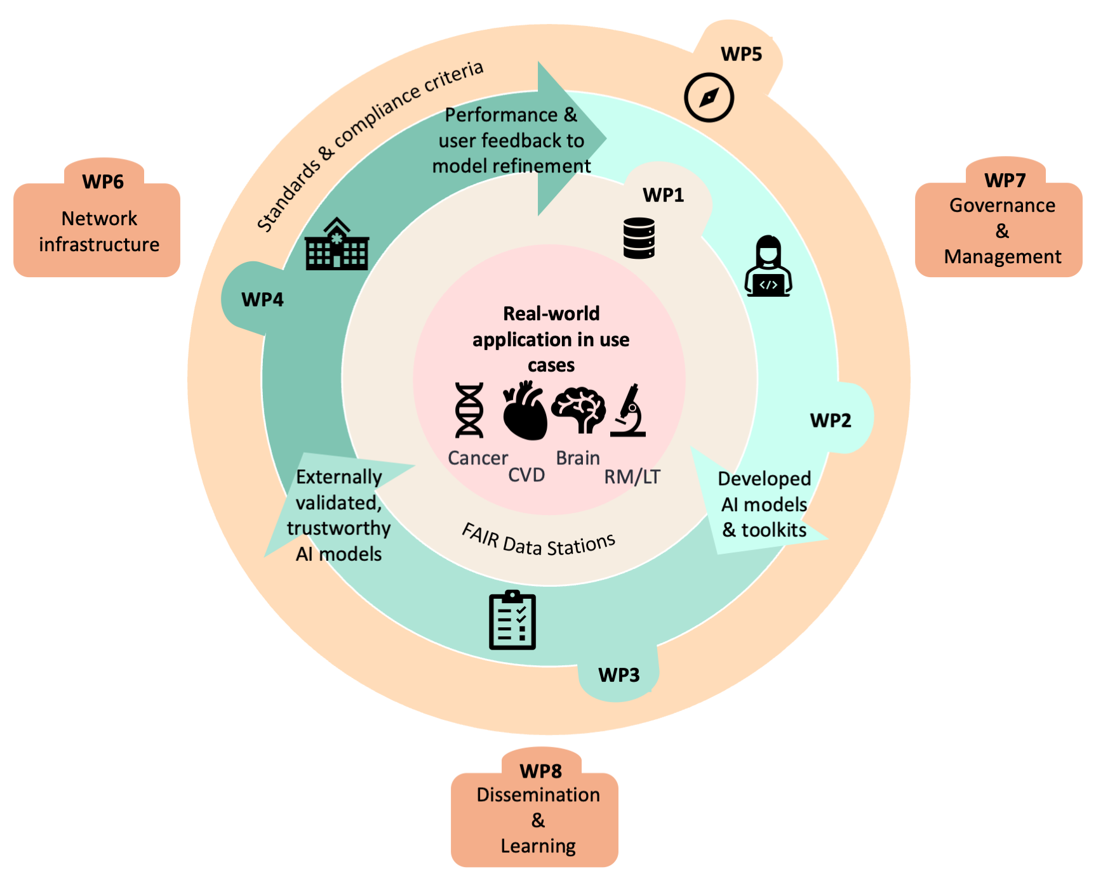
AI4HEALTH
9
Notes:
From focused (inner circle) to broad (outer circle). The whole system in ‘the room’, life-cycle approach on data and AI, focus on TRL, SRL, CRL.
Including behavioural changes and education → AI readiness/(il)literacy : WP6+8
WP8: consider mentioning that training (AI-literacy) is also an important component in our project, as a change in the ecosystem also requires behavioral change of all of those involved. This again highlights the importance of co-design with relevant stakeholders.

Slide 10
AI4HEALTH system approach leads to impact: scientific, societal, economical
Impact 2
More resource-efficient healthcare
Equitable care at the right time, right
place, by right caregiver, to right person
Impact 3
Smarter, faster, more efficient development & evaluation of healthcare innovations
Impact 1
More individualized care via human-centred, co-created & co-evaluated AI technologies
National blueprint for FAIR and sustainable data use

Slide 11

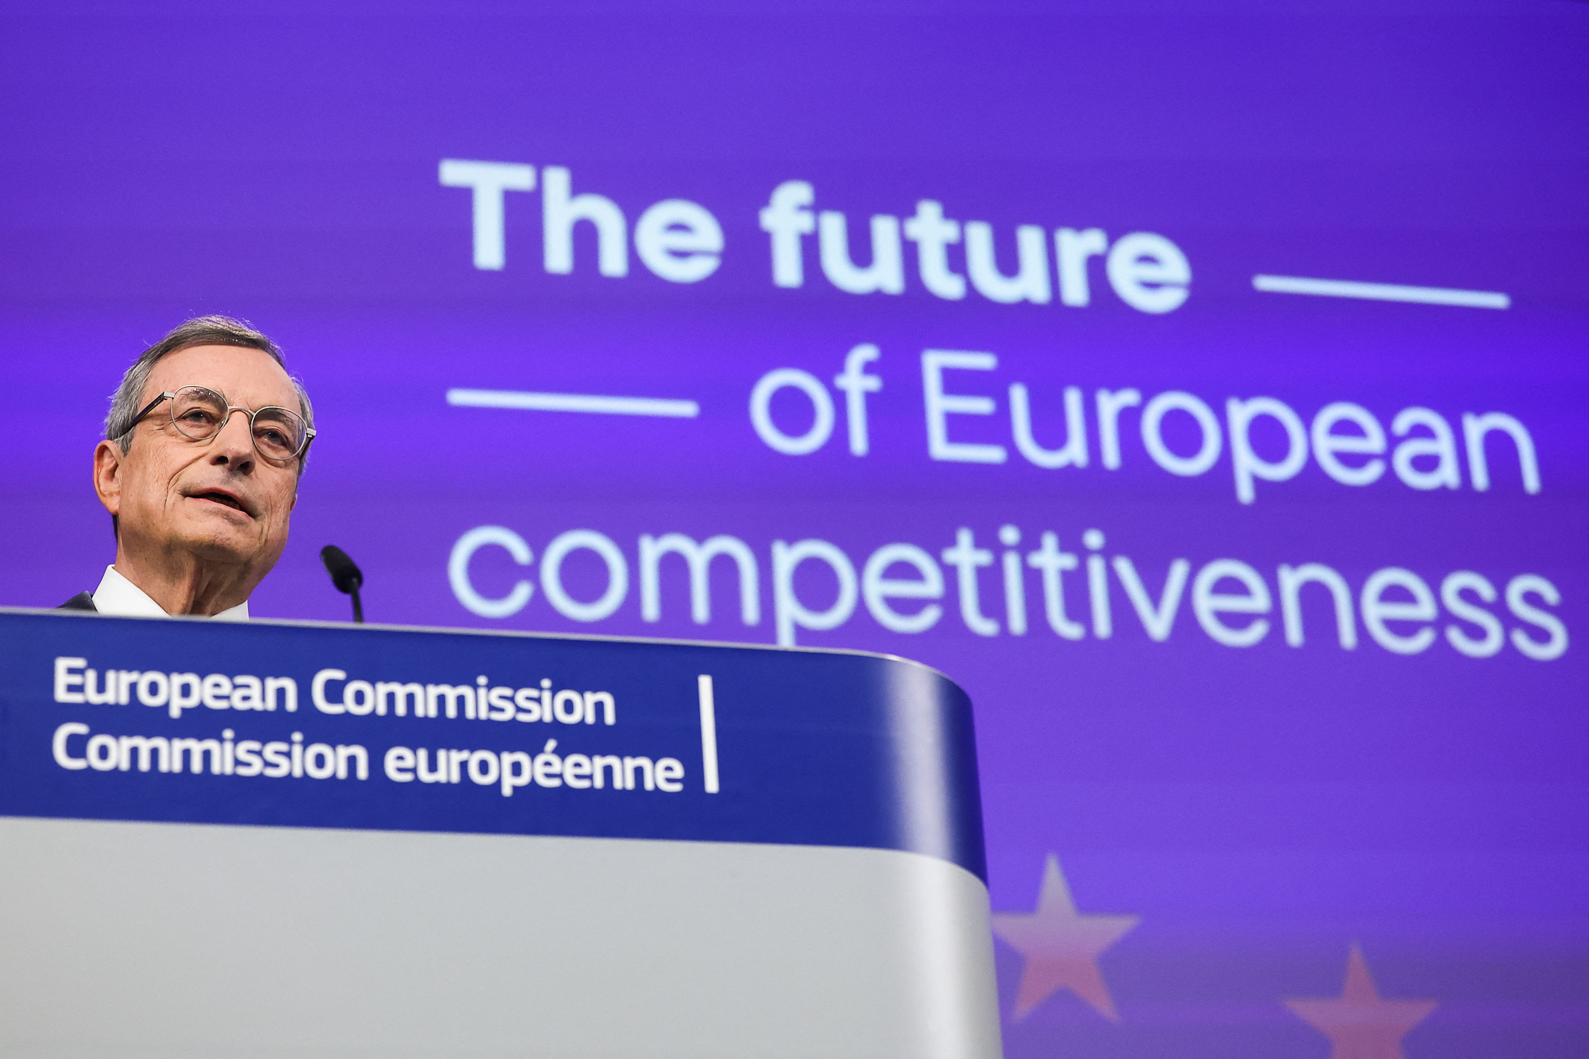


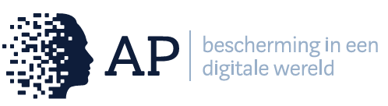


“Wat me het meest raakte in de vele gesprekken voor dit rapport, is dat de wil om te verbeteren overal aanwezig is, maar dat mensen het gevoel hebben dat het systeem hen belemmert.”
AI4HEALTH timely, situationally precise, aligned with current needs.
“Addresses urgent healthcare challenges on data reuse, AI adoption, workforce pressure, and system sustainability, with clear links between problems, research, and impact.”
“Interdisciplinary, multi-sectorial ecosystem capable of sustaining beyond the project to forward the excellent vision.”
Notes:
Data and AI strategy of Eu and Dutch: EU and Netherlands too – need to become indepedent of oversees. Invest, Invest, Invest and embark on it!!! Now before it is too late..
That’s why we got literally everyone that plays a role in the ecosystem/lifecycle, and obtained so much co-funding. Is the proof!!!
Onderdeel van de NTS/KIA zijn geworden - bij lancering op 26 januari.
(Zijn teveel op Nederlandse systeem aanpak geattendeerd. Marcel Levi bekrachtigde dit nog eens . Ai4health is de eerste stap daarnaar toe.)
AZWA

Slide 12
AI4HEALTH will transition the Data- & AI-ecosystem and
“allow the Netherlands to serve as a model for other countries.”
Thank you

